Slide 1
How do these paintings connect to the Hunger Games?
Notes:
After I read The Hunger Games, I was thinking of artwork that would connect with and depict some of the images and feelings portrayed in Suzanne Collins’ novel. I like to incorporate artwork into lessons when I can; so much of the humanities is related, yet we teach our subjects separately so students often don't see these connections between history, art, music, and literature.

Slide 2
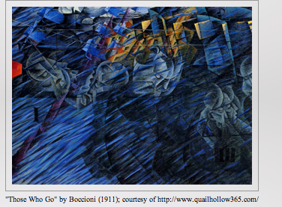
Notes:
One artist who always stood out for me was Umberto Boccioni, part of the Futurist art movement of the early 20th century. I used to teach art history as a nine-week course for freshmen; I would show them Boccioni’s sculpture Unique Forms of Continuity in Space (1913). After a brief discussion, we moved on to Picasso and the Cubists, so we never got to explore Boccioni’s paintings. The second piece is “Those Who Go.” The colors turn darker, the faces more sinister. I can’t help but think of the paradox that is the Capitol: a world of modern technology and seemingly perfect life, but also a place where these Tributes spend their last days, rather than with their families.

Slide 3
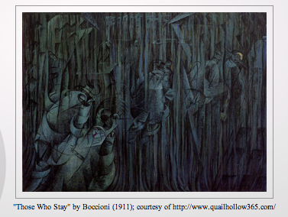
Notes:
“Those Who Stay” is the darkest of the series, showing muted colors with vertical lines. It conveys a depressed feeling. I am sure many of the families of the Tributes feel depressed after their children have left for the Games.

Slide 4
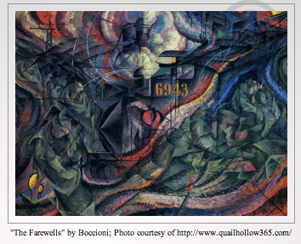
Notes:
Umberto Boccioni’s States of Mind series (1911) begins with “The Farewells” depicting subjects boarding a train--which in Boccioni’s time was modern transportation. For Katniss and Peeta, the train ride is also a new experience for them.

